Slide 1


FINAL PROJECT By Mr. Pradeep Ginjupalli, Ms. Rohini Desai, Mr. John DiSessa
AIRBNB BOSTON DATASET ANALYSIS

Slide 2
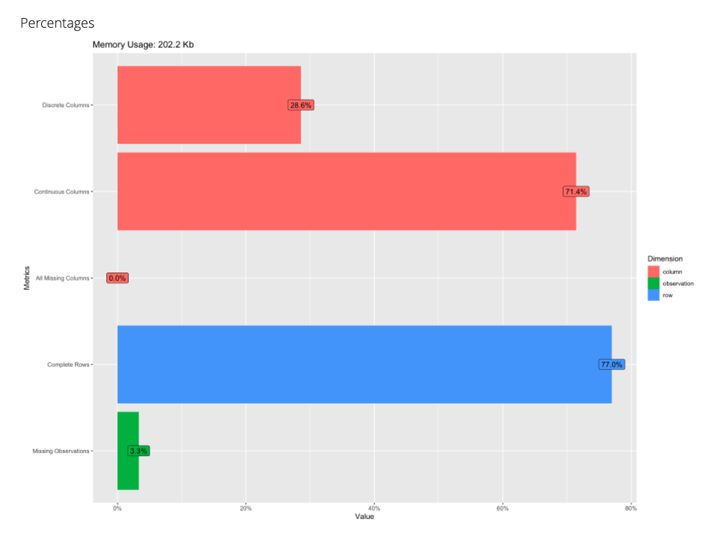
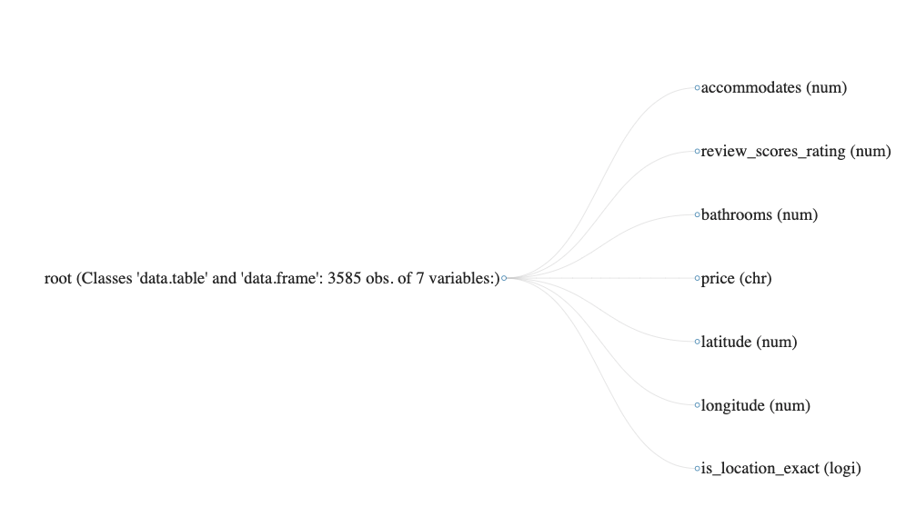
HIGH LEVEL DATA SUMMARY

Slide 3
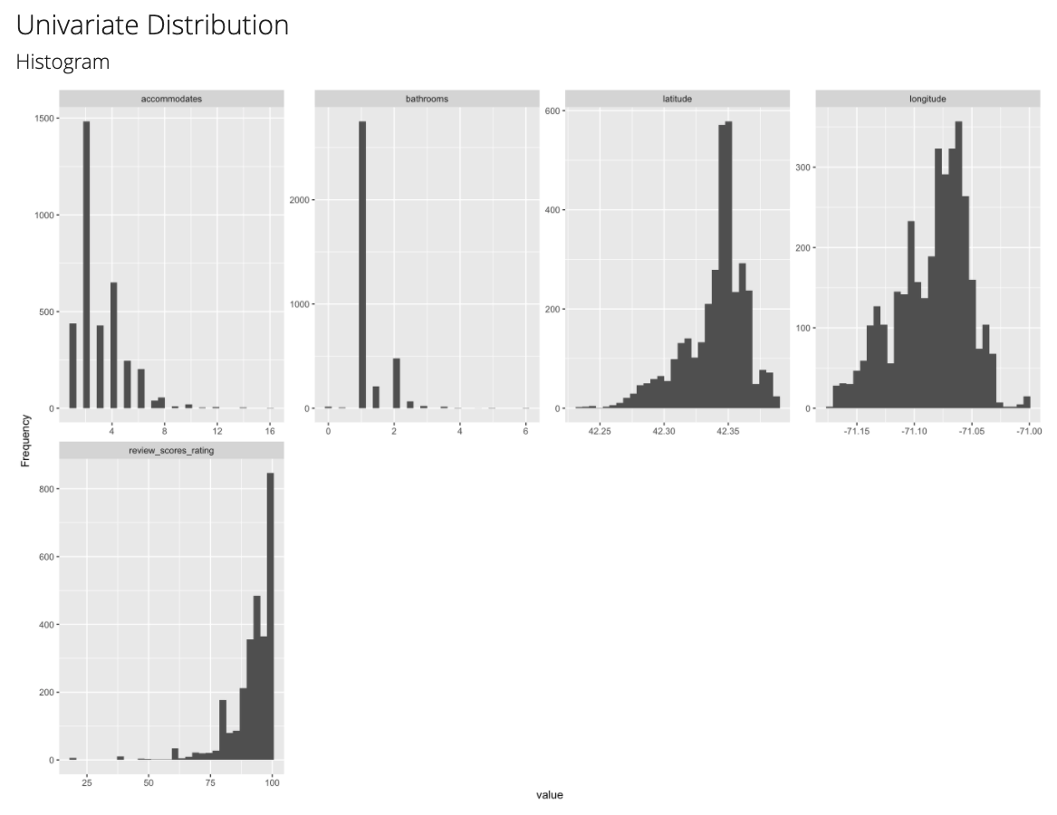
DATA PLOTS

Slide 4
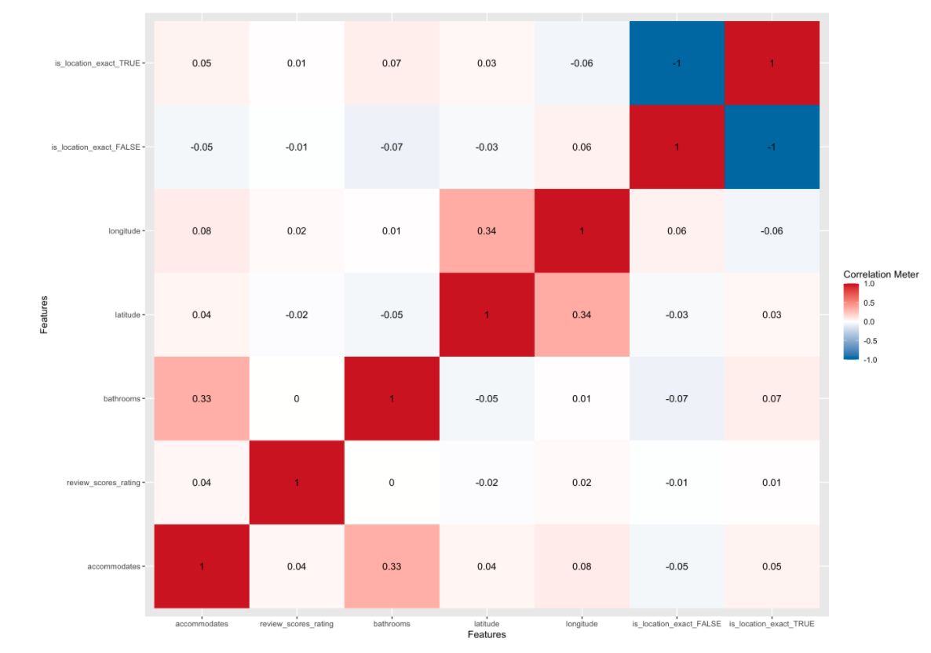
DATA PLOTS
Scatter plot and correlation matrix

Slide 5
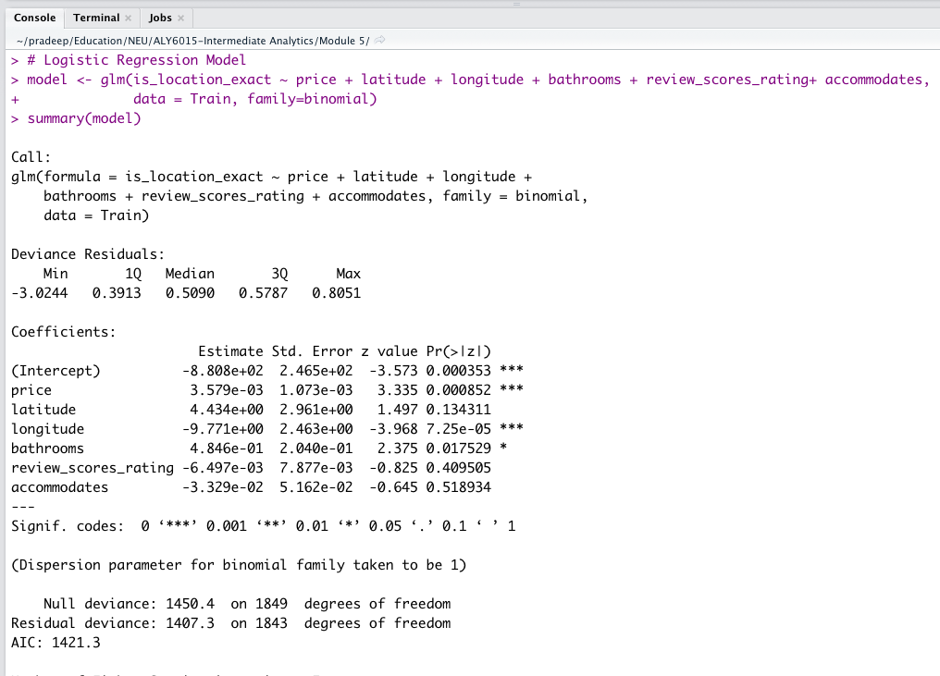

GLM MODEL
The goal with the GLM model fitting is to predict AIRBNB rental prices based on a few other variables.
The p-values for the regression coefficients reveal that all attributes except price, longitude, and latitude may not make a significant contribution to the equation, and we may not reject the hypothesis.

Slide 6
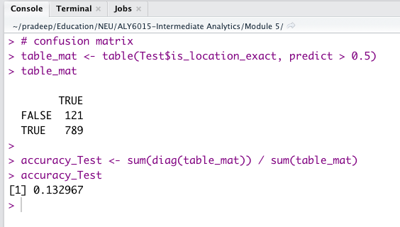
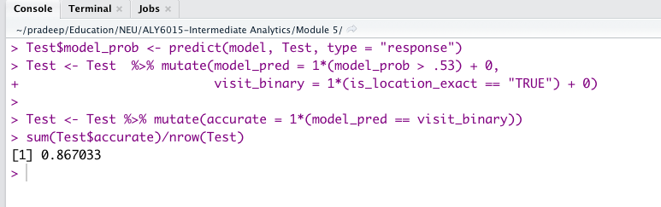
CONFUSION MATRIX
True positive is 789 and True Negative is 121
13.2% of accuracy indicates that identification of 1 of every 10 listing as overpricing is wrong and 9 are correct

Slide 7
ROC CURVE
The ROC curve depicted here shows the true positive rate (i.e., recall) against the false positive rate.
The area under the ROC curve seems to be a good way to evaluate and compare overall classification model performance.
We can see that our plot is significantly good, giving us the best prediction model.

Slide 8
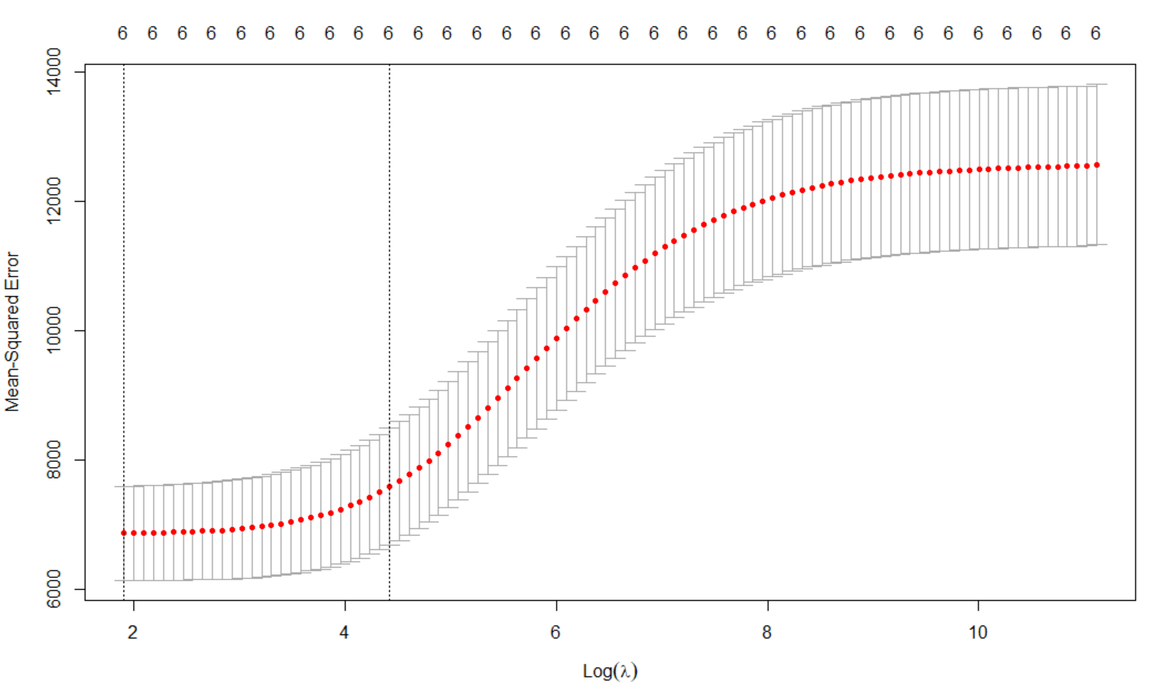
DATA VISUALIZATION AND ANALYSIS
Regularization used to reduce overfitting our model
LASSO vs. Ridge
Lambda (λ) min & Lambda (λ) maximum within 1SE

Slide 9
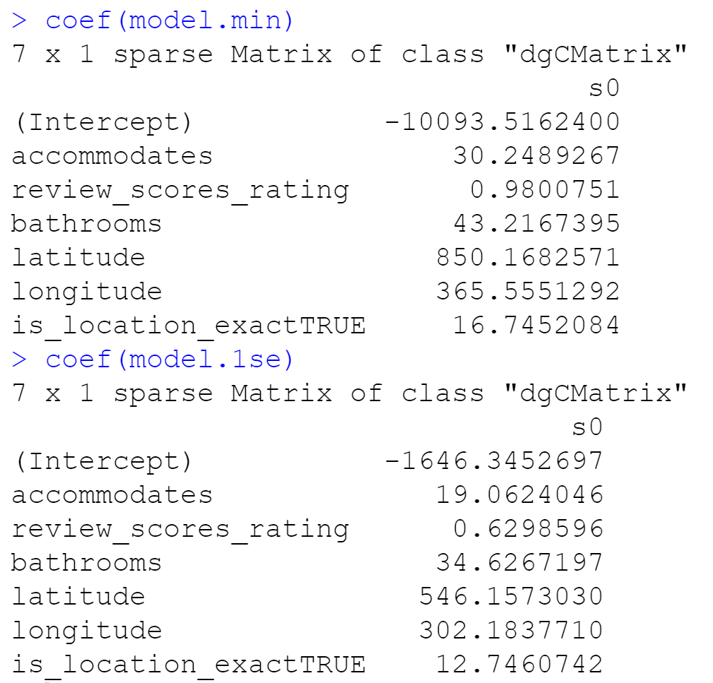
DATA VISUALIZATION AND ANALYSIS
Coefficient Adjustments
Root Mean Square Error calculations and comparisons
Lambda Min RMSE = 86.8
Lambda 1se RMSE= 82.3
Overfitting test

Slide 10

Future Considerations
Reviews & Calendar analysis
Non-Parametric tests
More models

Slide 11
KEY OBSERVATIONS
If prices are linear, our model was accurate about 87% of the time.
Using Lasso Regression we calculated the best lambda value in order to adjust our variable’s coefficients and thus, improved our model.
We predicted Airbnb price but were unable to predict other variables.

Slide 12
THANK YOU

Slide 13
REFERENCES
“RMSE: Root Mean Square Error.” Statistics How To, 31 May 2021, https://www.statisticshowto.com/probability-and-statistics/regression-analysis/rmse-root-mean-square-error/.
“Regularization: Ridge, Lasso & Elastic Net Regression.” DataCamp Community, https://www.datacamp.com/community/tutorials/tutorial-ridge-lasso-elastic-net.
What Is Lambda 1se?, https://askinglot.com/what-is-lambda-1se.
“Cv.glmnet: Cross-Validation for Glmnet.” RDocumentation, https://www.rdocumentation.org/packages/glmnet/versions/4.1-2/topics/cv.glmnet.

